Slide 1

DX University
Visalia California – 2014

Slide 2
Station & Antenna Considerations
Ned Sterns AA7A

Slide 3

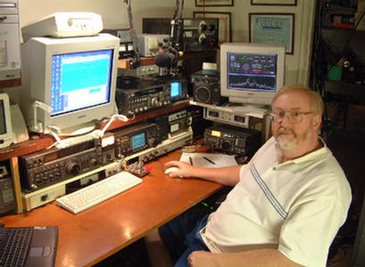
Ned Stearns AA7A
First licensed in 1963 at age 12, he has been a serious Dxer since 1974.
Top of the Honor Roll, 5BWAZ, Satellite DXCC, and the first ever 11-band DXCC (160 through 2 meters, inclusive).
Dxpeditions in 1979 as AA7A/VP2A ; 1999 as 3B9R ; 2000 as K5K.
Member of the VooDoo Contest Group since 2005. Currently the team co-leader and station designer.
Serves as a director on the NCDXF.

Slide 4
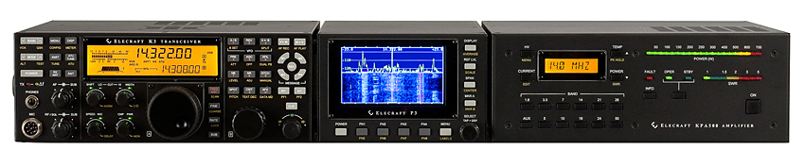
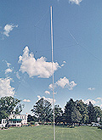

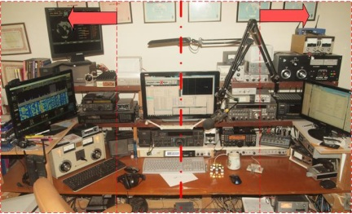
Topics
Radios
Antennas
Other Station Elements
Station Layout

Slide 5
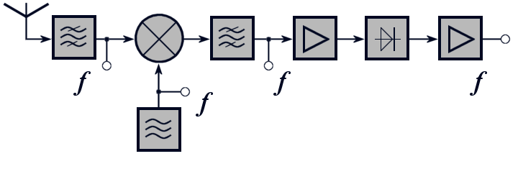
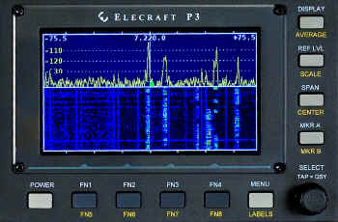
Radio Equipment - Receivers
Critical receiver requirement
  Selectivity
  Dynamic range
  Split frequency operation
Advanced capability
  Second receiver or sub-receiver
  Diversity reception
  Panadapter displays
  Software Defined Radios (SDR)

Slide 6
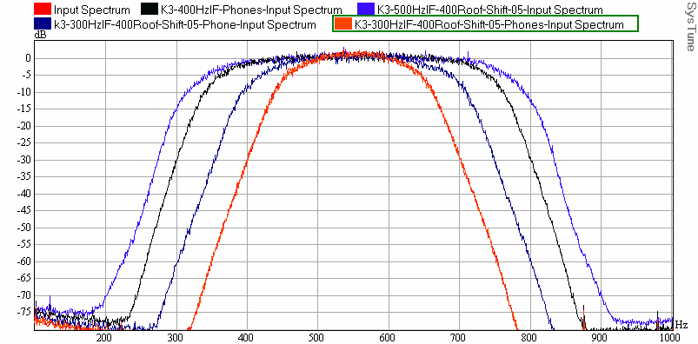
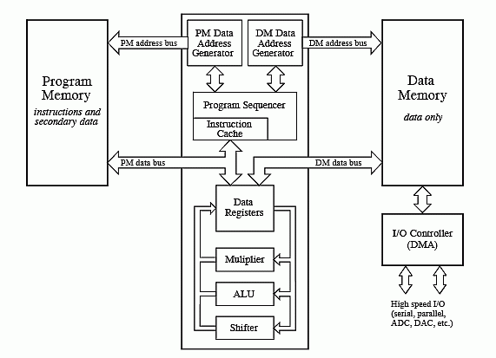
Receiver Selectivity
Roofing Filters
  Limits power applied to non-linear receiver elements
Digital Signal Processing
  Bandpass filters
  Notch filters
  Noise Reduction algorithms
  Noise Blanking

Slide 7
Receiver Dynamic Range
One simple definition: Blocking Dynamic Range
    Copy a weak signal simultaneously with a high level, off-channel signal
    Ratio of signal amplitudes at point when degradation of weak signal starts
Radio | BDR, dB
Elecraft K3 | 139
Ten Tec Orion II | 136
Yaesu FTdx9000D | 127
ICOM IC-7800 | 115
ICOM IC-756PROIII | 101

Slide 8
Transmitter - Critical Requirements
Power level
  Heat is at the root of most component failures
  Consider operating radios well below maximum power levels
Modulation Quality – How good (or wide) is your signal?
  Undesirable sidebands – clicks or ɸ noise will get you noticed
  Reduce audio distortion – audio processing may result in higher average power but can result in lower understandability
Consider covering all the operating modes
    Traditional modes (CW, SSB, AM, RTTY) are native
    New modes (e.g. PSK, JT65) may require external modems

Slide 9
Antennas
Requirements related to effective DXing
  Pattern matching propagation path to DX
  Pattern reducing effects of interference
  Efficiency
General characteristics
  Efficient antennas are likely to be narrowband
  Antennas are the best investment in your station
  Reliability can be more important than performance
  Higher antennas work DX better than lower ones

Slide 10
Low frequencies antennas (160 & 80 m)
Transmit antennas
Verticals
Dipoles (as high as possible)

Slide 11
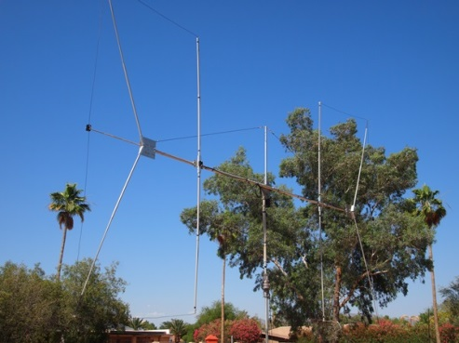
Low frequencies antennas (160 & 80 m)
Receive antennas
Beverages
Loops
(ground-dependent antennas)
Flag/pennants
(ground-independent antennas)
4-square short verticals

Slide 12
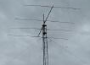
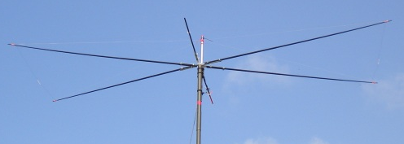
Antennas - HF
Monoband antennas
  Full size: Yagi¹
  Shortened: Moxon²
1
2

Slide 13
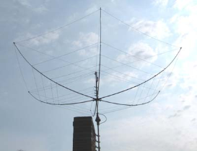
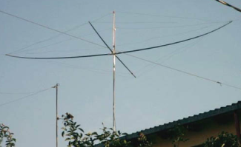
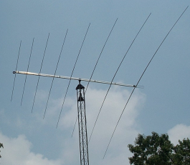
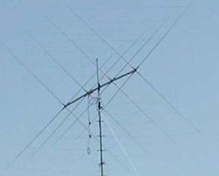
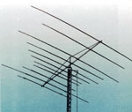
Antennas - HF
Multi-band antennas (Fixed)
Hexbeam¹
Spider beam²
Log periodic³
Quad⁴
Multiband Yagi⁵
1
2
3
4
5

Slide 14
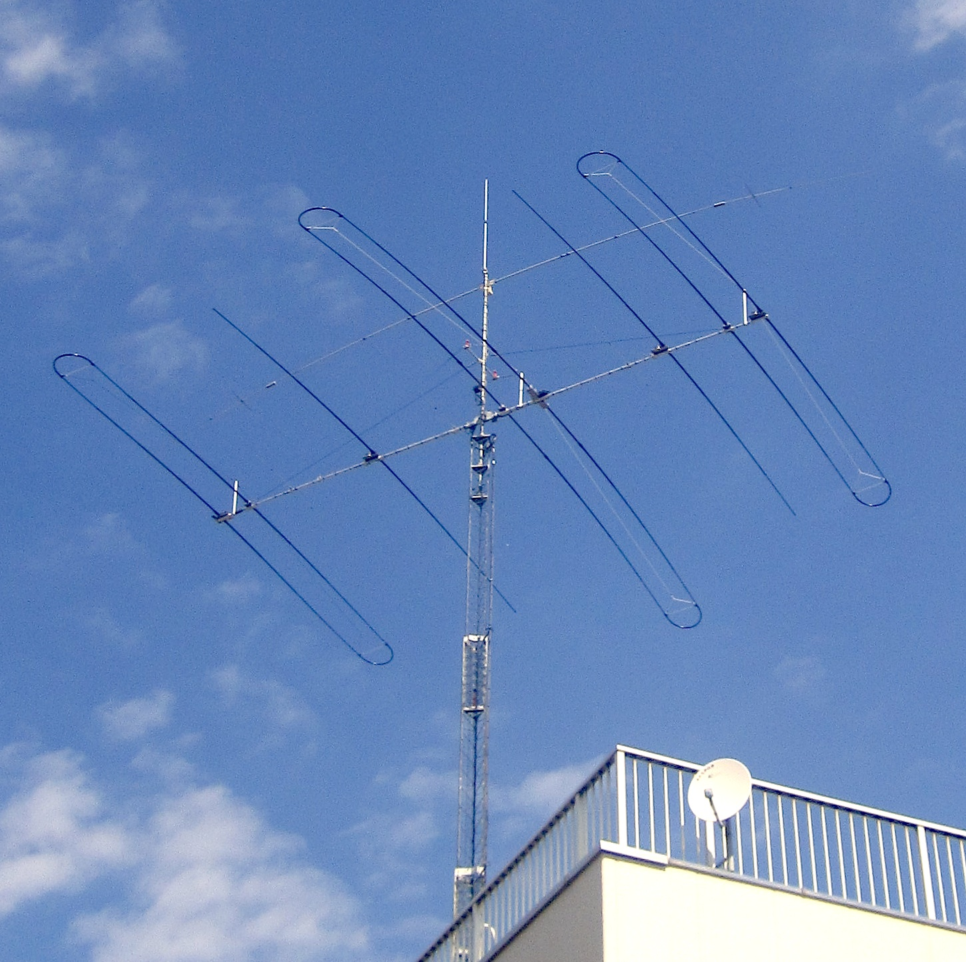
Antennas - HF
Adjustable
SteppIR

Slide 15
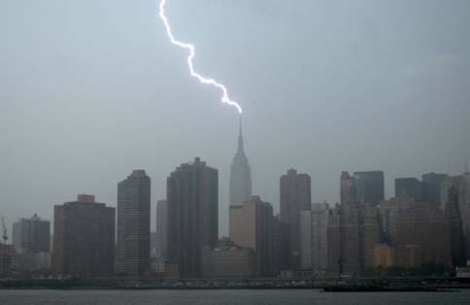
Other Station Elements
Grounding
  Nearby lightning strike protection
  Shock hazard mitigation
  Audio ground loop reduction

Slide 16
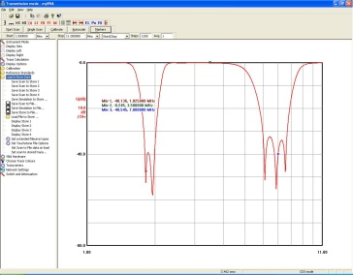
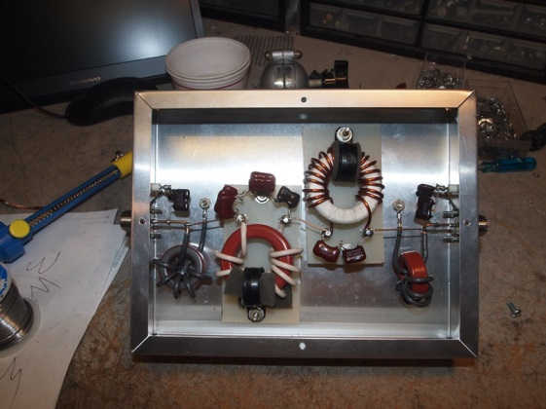
Other Station Elements
Filtering
  Harmonic suppression
  BCI reduction
  Protection of local equipment

Slide 17

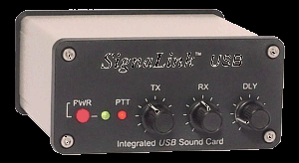
Other Station Elements
Audio Transducers
  Headphones / speakers
  Microphones
  PC CODECs

Slide 18

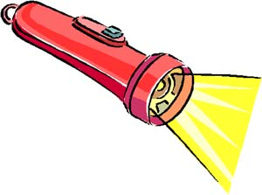

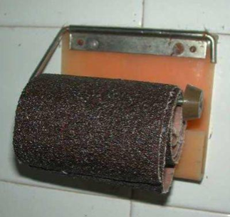
Station Layout Considerations
Reduce stress and strain
  Organization of equipment
  Neck strain reduction
  Minimize eye strain
Lighting
  Must see the radio knobs
  Must see keyboards
Ambient sound
  Fan noise
  Clunking relays
Posterior comfort

Slide 19
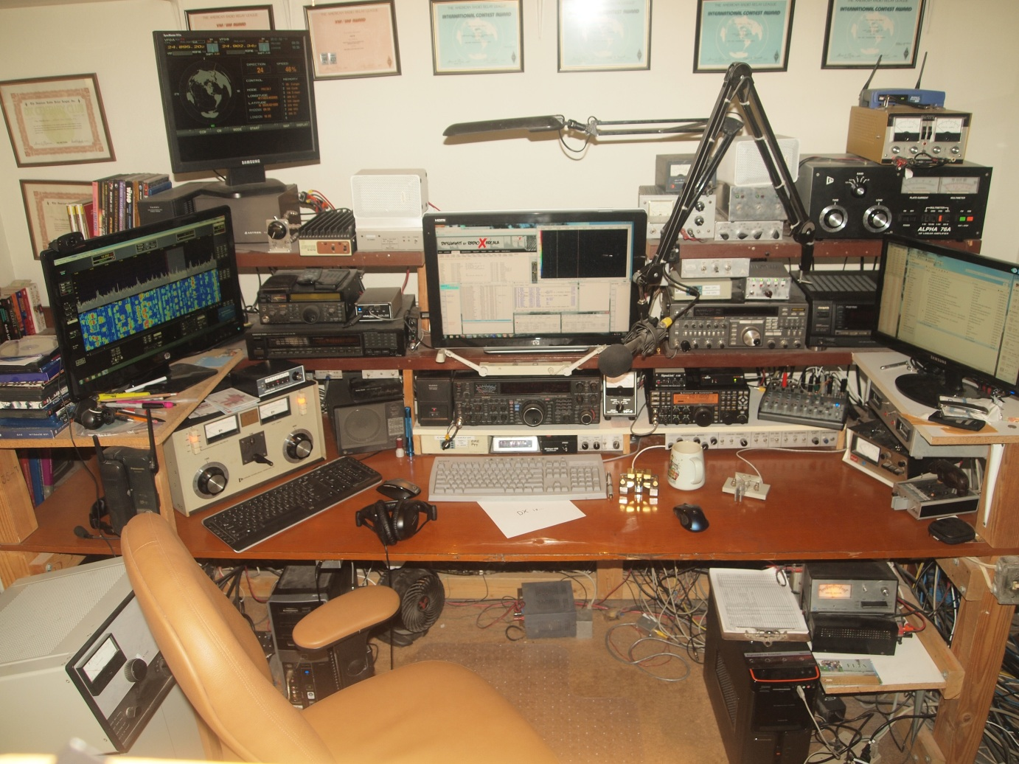
AA7A Station – 10 Feb 2012 (at 1646 Z )
Rotor Display
HF Radio #1
HF SDR #3
HF Amplifier #2
SDR Display
HF Radio #2
HF Logging Computer mon #2
HF Logging Computer mon #1
HF Amplifier #1
12-channel Audio Mixer
HF Wattmeter
HF Amplifier #3

Slide 20

AA7A Station – Operator Focus
Secondary Focus
Primary Focus
Secondary Focus

Slide 21
Station & Antenna Considerations
Happy Hunting!
Notes:
LAST SLIDE IN PRESENTATION

